Slide 1



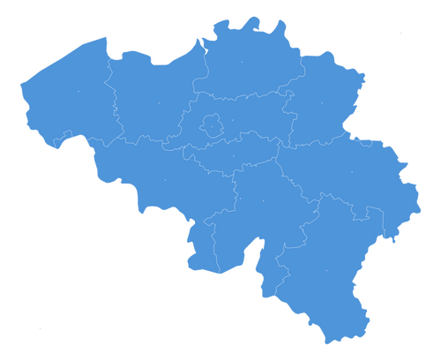
A TRUSTED CHEMICAL DISTRIBUTION PARTNER
Empowering Global Suppliers and Customers Through Market Intelligence, Precision, and Entrepreneurial Spirit
BloomchemAG Private Limited, India
BloomchemAG BV, Belgium

Slide 2








01
Who We Are
02
Strategic Direction
Company Introduction
Vision & Mission
What’s inside this deck
03
Market Landscape
04
Industry Realities
Global & European Overview
Challenges & Opportunities
05
How We Operate
06
What We Offer
Eight chapters.
One story of growth,
trust & sustainability.
Business Model
Product Portfolio
07
Credentials
08
Our People
Awards & Certifications
Diversity & Team

Slide 3

Partnering Global Chemicals and Life Science Companies
BloomchemAG bridges the gap between global chemical producers and end-users, delivering expertise, reliability, and market-driven solutions at every step of the supply chain.

Slide 4
Disclaimer
This presentation has been prepared by BloomchemAG (the 'Company'), the content of which was compiled from sources believed to be reliable for informational purposes only. It is based on information regarding the Company and the economic, regulatory, market, and other conditions in effect as of the date hereof. Subsequent developments may impact the information contained in this presentation. Neither the Company nor its advisors or representatives are under any obligation to update, revise, or affirm this information. The contents of this presentation do not constitute an offer or invitation for sale or subscription, nor a solicitation to buy or subscribe for any securities. It should not form the basis of, or be relied upon in connection with, any contract, commitment, or investment decision in India or any other jurisdiction.
Prospective and existing stakeholders, including investors and customers, should independently evaluate the Company, as this presentation does not claim to be
all-inclusive or to contain all information that an investor may require. Interested parties should conduct their own due diligence before making any decisions. The Company makes no representation or warranty regarding the accuracy or completeness of this information and assumes no liability for any errors or omissions or for any written or oral communications made during the evaluation process.
This presentation may contain certain "forward-looking statements" based on assumptions and expectations of future events. Actual performance, outcomes, and results may differ materially from those expressed in forward-looking statements due to various risks, uncertainties, and assumptions. Although these forward-looking statements are based on reasonable assumptions, there is no assurance that such expectations will be realized. Neither the Company nor its advisors or representatives are obligated to update forward-looking statements or adjust them to reflect future events or developments.

Slide 5

BloomchemAG commitment to growth & sustainability
The European chemical industry is at a pivotal moment, navigating rising energy costs, global overcapacity, and sweeping regulatory shifts. At BloomchemAG, we see these challenges not as obstacles, but as opportunities to lead.
Since our founding in 2013, we have grown from a focused distribution firm into a globally recognized supply chain partner, ranked 145th in the ICIS Top European Chemical Distributors.
Our competitive edge rests on three pillars:
Cost Leadership - Ensuring our clients always receive the most competitive pricing in the market
Reliable Deliveries - Delivering with consistency, precision, and accountability every time (95% customer retention rate)
Long-Term Partnerships - Building relationships that go beyond transactions to create shared growth
Looking ahead, our strategy is clear: expand our European footprint, deepen market intelligence capabilities, and strengthen relationships with "Actual Users" and "Last-Mile Connectors."
At BloomchemAG, customer-centricity, innovation, trust, and ethics are not aspirational values - they are our operating principles.
“
True leadership is about shaping industries, creating lasting impact, and empowering future generations with sustainable solutions.
Rajesh Sethi, CEO
REACH Compliant · ISO 9001:2015 Certified · EcoVadis Certified.

Slide 6
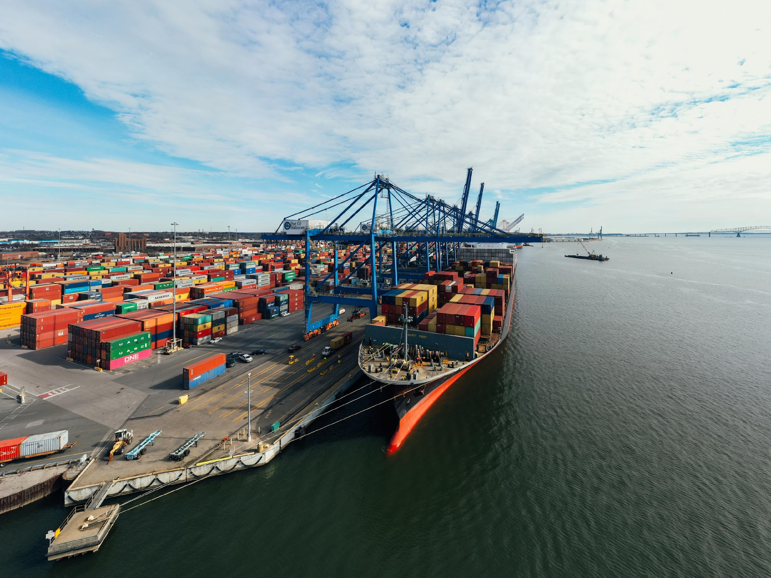




Introducing BloomchemAG: your chemical distribution partner
BloomchemAG is an acronym which conveys our area of operation and expertise:
Bloom: is flowering and growing,
chem: is from Chemistry,
AG: is from Agriculture
BloomchemAG was established in 2013 with an objective to increase footprint in Indian subcontinent and conversely support Indian and other Asian specialty chemical producers to scale-up their operations and gain larger share of global markets.
We are a Europe-focused chemical distribution and international trading supply chain company in the field of Specialty Chemicals. BloomchemAG understands the bridge between “Local Europe” & “Global Trading”.
We import and store Specialty Chemicals in major European Ports of Antwerp, Rotterdam and Hamburg and distribute to customers in Europe, as per their call-off dates. We enable our customers to achieve economies of scale and offer them a synergy of chemical products and value-added services.
We connect chemical manufacturers (our principals) and chemical users (our customers) across the world. Our customers and principals / producers know us as a pro-active company with short lines of communication and quick decisions.
To streamline European operations, we set up Bloomchemag BV - a wholly-owned subsidiary based in Mol, Belgium, since January 2014.

Slide 7

Strategic overview: driving global success in chemical distribution
Industry-Leading Distribution Solutions
BloomchemAG is a distribution firm specializing in industrial and specialty chemicals, serving wide application areas. With expertise spanning diverse industries, we offer strategic outsourcing solutions to global clients. We aspire to strengthen our market presence by capitalizing on the robust demand for our products in the West, allowing us to leverage the cost advantages of sourcing from Asia.
Our approach involves providing tailored product and service solutions by deeply understanding our clients' manufacturing processes and analyzing their feedstock markets.
Driving Growth and Innovation
BloomchemAG bv is committed to simplifying the complexities of global sourcing and supply chain. With our top-line revenue exceeding EUR 26 Million, we have achieved this through our deep understanding of markets, expertise in technical and supply chain operations, and innovative approach to new business and product development. We are aiming to double our Annual Sales Revenue to EUR 50 Million in the coming 3 years (till 2029). We are actively capitalizing on opportunities presented by the continuous outsourcing by European companies from Asia, foreseeing continued high annual growth.
13+
Years since Inception
45+
Employees
60+
Countries supplied to
230+
Customers Served
40+
Producers/Suppliers
Engaged
55+
Number of products offered
26,000+
Metric tons of chemical transported annually
31%
Sales to top 5 customers

Slide 8



Our vision & mission
Our Vision
Our Mission
To be a Reliable CRAMS player, Outsourcing and Chemical Distribution Partner for Global firms by offering Chemical Products and Services through Required Regulatory and importation, Storage and selling Infrastructure, Business Development, Sales Promotion and Distribution by Providing end-to-end Logistics to Customers’ doorstep globally.
We aim to closely work with global chemical suppliers and create value for them and for our global customers through our knowledge, focus and entrepreneurial approach.

Slide 9



Navigating challenges: our resilient journey
Our Journey of Ambition, Resilience, and Success in Responsible Chemical Distribution
2025
Launched DPM, EP, ND-150
2023
Launched Dibasic ester and Methoxy Propanol
2024
2021
Began to Represent Harmony Organics Aroma Chemicals
Launched Acrylates and Propylene Carbonate
2022
Launched Triacetin,
ranked 150 in ICIS Top 100 chemical distribution (Now 145th)
2016
Launched DPDM
2014
2018
2015
Launched MPA and Glycol Ethers
Founded BloomchemAG BV; began Ethyl Acetate distribution from Hemiksem, Antwerp
Launched Acetic Anhydride and Benzyl Alcohol
2013
Incorporation of BloomchemAG
and entered European and Indian markets

Slide 10
Chemical distribution market: Global
Market Overview & Growth Outlook
Market Size (2024)
Projected by 2035
CAGR (2024–2035)
Fastest Growing Segment
~$302B
$553B
~5.8%
Specialty Chemicals
Global Baseline
GlobeNewswire, 2025
Compound Annual Growth
Market Size Trajectory (USD Billion)
$553B
Regional Share
$470B
Asia Pacific
Dominant Region
40%
$415B
Asia Pacific
$375B
$335B
Europe
$302B
28%
$245B
North America
22%
Pharma · Agri ·
Food & Bev
Rest of World
Key Drivers
10%
2022
2024
2026E
2028E
2030E
2032E
2035E
Sources: Grand View Research | Fortune Business Insights | GlobeNewswire, 2025

Slide 11
Global chemical distribution: industry-wise growth
End-use industry segmentation driving rapid market expansion globally
End-Use Industry
Market Share
CAGR
Key Market Insights
Pharmaceuticals & Healthcare
18%
7.2%
Pharma leads at 18% share - driven by post-COVID supply chain restructuring
Agriculture & Agrochemicals
16%
6.8%
Food & Beverage Processing
14%
5.9%
Electronics is fastest growing at 8.5% CAGR - fuelled by semiconductor chemicals
Personal Care & Cosmetics
10%
6.5%
Automotive & Transportation
9%
4.8%
Water Treatment CAGR 7.8% - reflecting global sustainability mandates
Construction Chemicals
8%
5.2%
Specialty chemicals outpacing commodities across all end-use verticals
Water Treatment
7%
7.8%
Electronics & Semiconductors
7%
8.5%
Agrochemicals surging with food security concerns across Asia & Africa
Other Industries
11%
4.5%
Sources: Grand View Research | Fortune Business Insights | GlobeNewswire, 2025

Slide 12
Chemical distribution market: Europe
European Market Analysis & Growth Drivers
Europe Market Size (2024)
Market Share by Country
Growth drivers
Regulatory Landscape
REACH & CLP raise the bar - creating a quality edge for compliant distributors.
Key Hubs: Germany · Netherlands (Rotterdam) · Belgium (Antwerp) · France · Switzerland · Poland
Antwerp–Rhine corridor expansion
Digital supply chain transformation
~$85B
Germany
26%
~28% of Global Share
France
14%
Projected by 2035
Belgium
11%
~$155B
Netherlands
10%
Strong compound growth
UK
9%
Europe CAGR
~5.4%
Italy
8%
Other EU
22%
2024–2035 Forecast
28,000+
Chemical Companies in EU
~€220 Billion
EU Chemical Exports (2024)
Antwerp–Rhine Corridor
Strategic Hub
Sources: Grand View Research | Fortune Business Insights | GlobeNewswire, 2025

Slide 13
Chemical distribution market: Europe
Europe's two most strategic chemical distribution hubs
Germany
Belgium
Market Size (2024)
EU Market Share
CAGR (2024–2035)
Market Size (2024)
EU Market Share
CAGR (2024–2035)
~$22B
~26%
~5.1%
~$10B
~11%
~5.7%
2024 Estimate
Largest in EU
Forecasted growth
2024 Estimate
3rd Largest in EU
Forecasted growth
Key highlights
Key highlights
The German chemical and pharma sector generates €220 billion in annual sales, representing 27% of total EU chemical output - making it the undisputed centre of European chemical activity.
Germany's specialty chemicals sector is projected to grow at a CAGR of 5.1% through 2035, with the focus on fine chemicals, coatings, adhesives, and EV battery materials, areas where German engineering expertise creates a durable competitive advantage.
Port of Antwerp: Europe's largest integrated chemical cluster
60M+ tonnes of chemicals handled annually through Antwerp
150+ chemical companies incl. 3 world-scale crackers
Belgium exports ~60% of its total chemical production
Sources: Grand View Research | Fortune Business Insights | GlobeNewswire, 2025 | VCI (German Chemical Industry) | Essenscia Belgium

Slide 14





Challenges in European chemical distribution industry
Logistics & Supply Chain Intricacies
Sustainability & Environmental Concerns
High Energy
Costs
Global
Competition
Global Overcapacity & Regulatory Changes
Coordinating a complex logistics chain with diverse sourcing locations
Strict import requirements poses a significant challenge for the chemical distribution industry.
Balancing sustainability with regulatory compliance is challenging.
Navigating the complexities of implementing TQM and HSE systems presents significant obstacles.
The specialty chemicals industry faces rising energy prices, significantly impacting production costs.
Companies must adopt energy-efficient processes and explore alternative energy sources to remain competitive.
Competing with established global chemical distributors poses a formidable challenge.
Addressing barriers to innovation and market expansion presents additional hurdles.
Excess production capacity in key markets leads to pricing pressures and reduced margins.
Frequent regulatory updates across regions require companies to continuously adapt to compliance requirements, increasing operational complexity.
Additional Regulatory Challenges:
German regulations such as EU REACH escalate compliance burdens for chemical distributors, causing complexity and potential fines, disrupting business operations.
EU REACH mandates supply chain transparency, necessitating the monitoring and resolution of labour and environmental violations.
Chemical distributors from India, China, and Vietnam encounter hurdles aligning with German regulations and broader EU initiatives like Carbon Border Adjustment Mechanism (CBAM).
BloomchemAG: Navigating Challenges, Ensuring Compliance, and Delivering Excellence in a Dynamic Chemical Landscape
Notes:
HSE : Health, Safety and Environment
TQM: Total Quality Management

Slide 15
Enablers for BloomchemAG’s growth
1
2
3
Cost Leadership
Deep & Long-Term Customer Relationships
Reliable Deliveries
Optimizing procurement and logistics helps companies offer high-quality products at competitive prices. This ensures sustained profitability, market leadership, and a strong competitive edge in the specialty chemicals industry.
Building trust, transparency, and responsiveness with customers leads to long-term partnerships. Understanding their needs and providing tailored solutions help drive mutual growth and industry leadership.
Consistent and timely deliveries are crucial for supply chain efficiency. Strong logistics, inventory management, and supplier networks help prevent disruptions and build customer trust.
4
5
Innovation
Focus on Sustainability
Investing in logistics is essential for staying competitive in the specialty chemicals industry. Indian companies must increase expenditure to 10% of revenue by the end of 2025 to drive innovation and technological advancements.
Sustainability is critical for long-term success. Compliance with government regulations and science-backed initiatives will shape industry growth and help achieve climate goals.

Slide 16




Value development for our stakeholders
  Suppliers
Customers
  Strategic Market Entry
  Efficient Supply Chain Solutions
Assisting global producers in entering global chemical markets.
Diverse sourcing and strategic logistics ensure timely deliveries. Sealed-ISO tank containers temporarily stored in Antwerp facilities.
  Scaling Operations
  Outsourcing Expertise
Supporting global producers to expand and gain global market share.
Procuring and managing resources for global clients.
  Market Knowledge Sharing
  Customer-Centric Approach
Facilitating collaborations and market insights.
Most European customers prefer DDP for close-to-requirement purchases, while Non-European are invoiced on CIF basis.
  Efficient Supply Chain
  Global Logistics
Cost-effective sourcing and logistics management.
Operations centered on Europe and Africa. Importing from Asia and strategically serving diverse markets.
BloomchemAG partnered with Asian suppliers and used Antwerp-Rotterdam
ports to cut costs and improve working capital efficiency.

Slide 17

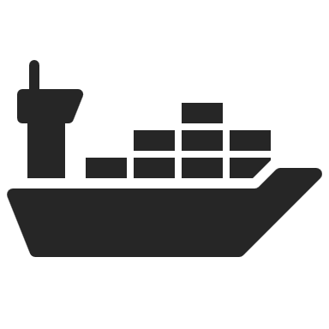




Business model
Suppliers
1-2 Weeks
Customers
1-2 Weeks
4-7 Weeks
China: 60%
India: 25%
Shipment
Planning
DDP Delivery to customer warehouse
through Inter modal or road transport
Deliver DDP to
customer
warehouse in EU
Transit in Sea
Others: 15%
(South Korea, Taiwan & Rest of Asia)
Antwerp-Rotterdam-Hamburg Area
DDP/FCA Deliveries
CIF Deliveries
Storage at Rotterdam:
Frans De Wit
C. Steinweg - Handelsveem B.V.
DVR warehousing BV
RBC Terminal
TLS Supply Chain Solution
Storage at Antwerp:
Katoen Natie
Blue Star storage - Altamira
ADPO
Bertschi Group
Storage at Hamburg:
Ernst Depot
CIF Deliveries to Barcelona/Genoa/Other Ports to Euro factor Approved Debtors

Slide 18
Customer delivery value chain
Producers
BloomchemAG
58%
4%
Last Mile
Connector
Traders
38%
Through local country value-addition i.e. breaking the bulk, warehouses, logistics services, etc.
Direct to the
end user
Through traders/ large
distributors/wholesalers
i
End User

Slide 19
Customer reach and revenue analysis
Customers Reached
Delivery Incoterms
*Customers reached till Mar 2025 annualized.
Our focus is mainly on DDP in delivery terms.

Slide 20







2027 strategic objectives
70+
280+
36,000+
40% +
95%
20%
(Above reference interest rate)
Number of
Products offered
Number of customers served
Metric tons of chemicals transported annually
2 Year CAGR
Revenue Growth
Customer Retention rate
Return on Capital Employed (ROCE)
16

Slide 21
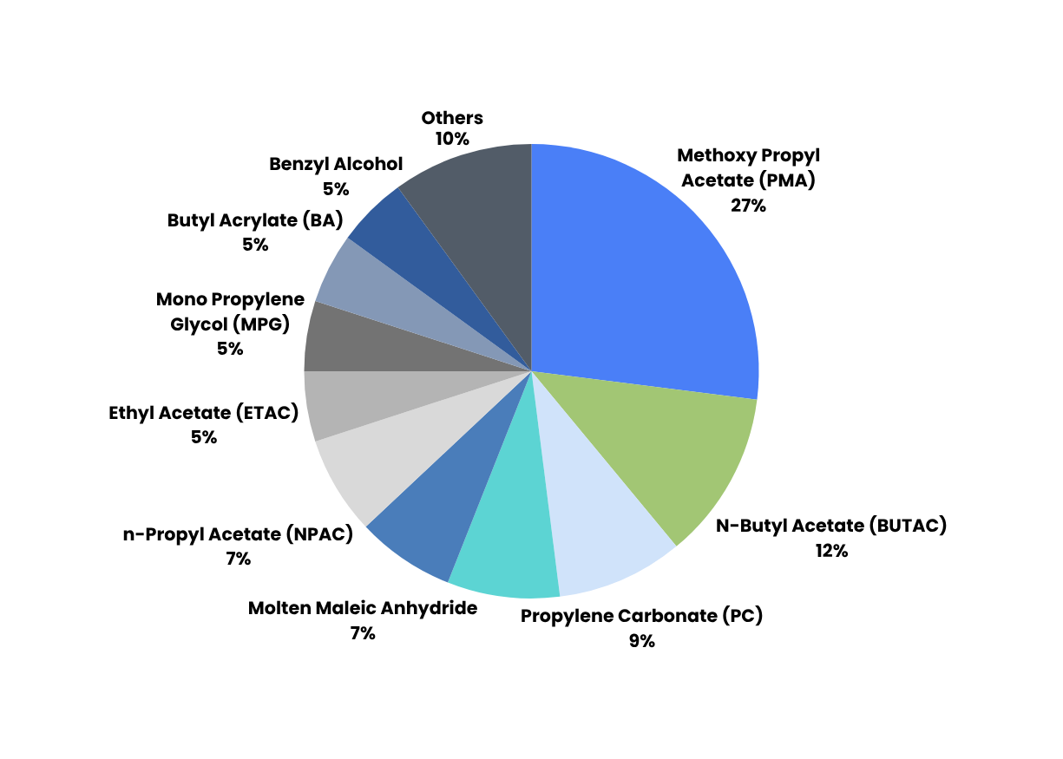

What drives our revenue
A diversified, resilient product mix with no single point of dependency.
Triacetin
8%

Slide 22

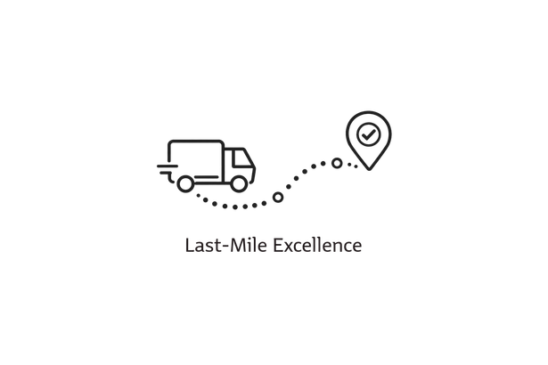


Antwerp-Rotterdam-Hamburg warehousing | Bulk material
Bulk (ISO Tank Containers)
Packed (Drums/IBC/Bags)
Bulk Products (ISO Tank Containers)
Methoxy Propyl Acetate (PMA) | ND-150
Methoxy Propanol (PM) | Dibasic Ester (DBE)
Dipropylene Glycol Monomethyl Ether (DPM) | Formic Acid 85%
Ethoxy Propanol (EP) | Benzyl Alcohol
Methyl Acetate (METAC) | Sorbitol 70%
Ethyl Acetate (ETAC) | Isopropyl alcohol (IPA)
n-Propyl Acetate (NPAC) | Triacetin (Palm Oil free/RSPO)
N-Butyl Acetate (BUTAC) | Maleic Anhydride Molten
Methyl Methacrylate (MMA) | Propylene Carbonate (PC)
Butyl Acrylate (BA) | Mono Propylene Glycol (MPG-USP/Tech)
2-Ethyl Hexyl Acrylate (2-EHA) | Methyl Ethyl Ketone (MEK)
2-Hydroxyethyl Methacrylate (2-HEMA) | Acetic Anhydride
n-Butyl Methacrylate (NBMA)
Diverse Industry Expertise
Strategic Sourcing
Smart Logistic Solutions
Last Mile Excellence
REACH Compliance
Recognition
EcoVadis 2026
In stock. Ready to Deliver. Built around your schedule.

Slide 23
Antwerp-Rotterdam-Hamburg warehousing | Packed material
Bulk (ISO Tank Containers)
Packed (Drums/IBC/Bags)
Packed (Drum/IBC/Bags) Products
Propylene Carbonate (PC) | Phthalic Anhydride (Flakes)
Methoxy Propyl Acetate (PMA) | Mono Propylene Glycol (MPG USP Grade)
Benzyl Alcohol | Methyl Ethyl Ketone (MEK)
Triacetin (Food / Technical / Palm Oil Free/ RSPO) | Methyl Metha Acrylate (MMA)
Maleic Anhydride (Briquettes) | Trimethylolpropane (TMP)
Acrylic Acid (AA) | Benzoic Acid
N-Butyl Acetate (BUTAC) | Trimellitic Anhydride (TMA)
2-Hydroxyethyl Methacrylate (2-HEMA) | Bisphenol-A
Aroma Chemicals
Phenyl Ethyl Alcohol (PEA)
Phenyl Ethyl Phenyl Acetate (PEPA)
Cinnamic Aldehyde
Cinnamic Alcohol
Phenyl Ethyl Methyl Ether (PEME)
Benzyl Acetone
Phenyl Ethyl Acetate
Styrallyl Acetate
Diverse Industry Expertise
Strategic Sourcing
Smart Logistic Solutions
Last Mile Excellence
REACH Compliance
Recognition
EcoVadis 2026
In stock. Ready to Deliver. Built around your schedule.

Slide 24


Aroma chemical distribution
Exclusive. Reach-certified. Ready for Europe.
Exclusive Partnership for Business Continuity
Readily Available Stock & Flexible Delivery
Exclusive REACH-Certified Distributor in Europe
We have partnered exclusively with Harmony Organics Pvt Ltd to ensure businesses achieve continuity and confidence in their operations.
With readily available stock in Rotterdam and Antwerp, we offer flexible packaging and delivery options, including drums, IBCs, ISO Tanks, and bulk deliveries for seamless operations.
We’re excited to announce that BloomchemAG is now the exclusive distributor of REACH-Certified specialty chemicals across Europe, expanding our portfolio with a new range of Aroma Chemicals.
Stock Ready. Delivery Flexible. Rotterdam and Antwerp inventory available now. Drums, IBCs, ISO Tanks, and bulk formats, your way, your schedule.

Slide 25
Aroma chemicals: flavours & fragrances
Introducing Aroma Chemicals with Harmony Organics
Our Portfolio is expanding to offer you an even wider selection, for our clients already benefiting from our existing offerings, like Benzyl Alcohol and Triacetin the addition of “Aroma Chemicals” portfolio provides immediate advantages, offering the flexibility to purchase both established and new solutions through a single source. Our expanded selection allows you to streamline your supply chains and achieve quicker turnaround times for orders.
Product Name (with packing 200kg MS epoxy coated drums) | CAS No
Phenyl Ethyl Alcohol (PEA) | 60-12-8
Phenyl Ethyl Phenyl Acetate (PEPA) | 102-20-5
Cinnamic Aldehyde | 104-55-2
Phenyl Ethyl Methyl Ether (PEME) | 3558-60-9
Benzyl Acetone | 2550-26-7
Phenyl Ethyl Acetate (PEAC) | 103-45-7
Styrallyl acetate | 93-92-5
Diverse Industry Expertise
Strategic Sourcing
Smart Logistic Solutions
Last Mile Excellence
REACH Compliance
Recognition
EcoVadis 2026

Slide 26
EU REACH products portfolio: applications
Flavors & Fragrances (Aroma Chemicals)
Personal Care & Cosmetics
Plasticizers
Performance Chemicals
Printing Inks, Coating & Adhesives
Aldehyde C16 (Strawberry Aldehyde)
Benzaldehyde
Benzyl Acetate
Benzyl Alcohol (Tech & Food Grade)
Benzyl Benzoate
Benzyl Silicate
Cinnamic Alcohol
Cinnamic Aldehyde
Phenoxy Ethyl Iso Butyrate
Phenyl Ethyl Acetate
Phenyl Ethyl Alcohol
Phenyl Ethyl Methyl Ether
Phenyl Ethyl Phenyl Acetate
Pine Oil
Styrallyl Acetate
Styrene Oxide
Terpineol
Terpinyl Acetate
Triacetin
Triethanolamine (TEA)
1,3-Butylene Glycol
Acetone
Isopropyl Alcohol (IPA)
SLES 70%
Sodium Benzoate
Sodium Sulfide (60% Yellow Flakes)
1,6-Hexanediol (1,6-HDO)
2-Ethyl Hexyl Acrylate (2-EHA)
2-Hydroxy Propyl Methacrylate (2-HPMA)
2-Hydroxyethyl Methacrylate (2-HEMA)
Acrylic Acid (AA)
Bisphenol A (BPA)
Glacial Acrylic Acid (GAA)
Methacrylic Acid (MAA)
Purified Terephthalic Acid (PTA) Tetrahydrofuran (THF)
Triethyl Phosphate Trimellitic Anhydride (TMA)
Benzyl Alcohol
Butyl Acrylate
2-Ethyl Hexyl Acetate
Maleic Anhydride (Molten / Briquettes)
Phthalic Anhydride (Flakes)
Isophthalic Acid
Calcium Hydroxide
Caustic Soda (Solution, Flakes & Prills)
N-Methyl-2-Pyrrolidone (NMP)
Ethylene Carbonate (EC)
Propylene Carbonate (PC)
Trimethylol Propane (TMP)
Butyl Acetate (BUTAC)
Butyl Acrylate (BA)
Dibasic Ester (DBE)
Ethyl Methacrylate
Ethoxy Propanol (EP)
Isopropyl Acetate (IPAC)
Methoxy Propanol (PM)
Methoxy Propyl Acetate (PMA)
Methyl Acetate (METAC)
Methyl Ethyl Ketoxime (MEKO)
Methyl Isobutyl Ketone (MIBK)
N-Butyl Methacrylate
N-Propyl Acetate (NPAC)
Sodium Methyl Allyl Sulphonate (SMAS)
Toluene
Vinyl Acetate Monomer (VAM)
Polytetramethylene Ether Glycol
(PTMEG)
Dipropylene Glycol Monomethyl
Ether (DPM)
Dipropylene Glycol Dimethyl
Ether (DPDM)
Dimethylformamide (DMF)
N-Ethyl-2-pyrrolidone (NEP)
ND-150
Rubber / Latex
Pharma, Food & Feed
Carbon Black
Methyl Ethyl Ketone (MEK) Methyl Methacrylate (MMA) Potassium Chloride -Tech Grade
Acetic Acid (Food Grade)
Acetic Anhydride (AAH)
Benzoic Acid (Tech Grade 99%)
EDTA (Sodium Salts)
Ethyl Acetate (ETAC)
Ethylamine (Mono, Di, Tri) Polysorbate
Formic Acid 85%
Sorbitol (Liquid / Powder)
Resins
Plant Protection / Agriculture
Triacetin (Food Grade / Tech Grade / RSPO / Palm Oil Free)
Benzyl Alcohol
Epoxy Reactive Diluents
Hardener & Epoxy Resin
Maleic Anhydride (Molten / Briquettes)
Mono Propylene Glycol (MPG)
Neopentyl Glycol (NPG)
Phthalic Anhydride Flakes
Styrene
Monoethanolamide (MEA)
Phosphoric Acid (75% & 85%) Propionic Anhydride Tertiary Amines
Flame Retardants
Tris (2-Chloro Isopropyl)
Phosphate (TCPP)

Slide 27
EU REACH products portfolio: chemical groups
Acrylates/Acrylic Monomers
Solvents
Alcohols / Diols / Polyols
Phosphorus Derivatives
Benz Products
2-Ethyl Hexyl Acrylate (2-EHA)
2-Hydroxyethyl Methacrylate (2-HEMA)
2-Hydroxypropyl Methacrylate (2-HPMA)
Acrylic Acid (AA)
Butyl Acrylate (BA)
Ethyl Methacrylate
Glacial Acrylic Acid (GAA)
Methacrylic Acid (MAA)
Methyl Methacrylate (MMA)
Sodium Methyl Allyl Sulphonate (SMAS)
2-Ethyl Hexyl Nitrate
N-Butyl Methacrylate
Dibasic Ester (DBE)
Formic Acid (FA 85%)
Methyl Ethyl Ketone (MEK)
Methyl Ethyl Ketoxime (MEKO)
Methyl Isobutyl Ketone (MIBK) Dimethylformamide (DMF) Propylene Carbonate (PC) Tetrahydrofuran (THF)
N-Ethyl-2-pyrrolidone (NEP) Ethylene Carbonate (EC)
ND-150
1,3-Butylene Glycol
1,6-Hexanediol(1,6-HDO)
Bisphenol A (BPA)
Ethoxy Propanol (EP)
Diacetone Alcohol
Iso-Propyl Alcohol (IPA)
Neopentyl Glycol (NPG)
Sorbitol (Liquid / Powder) Trimethylolpropane (TMP)
Phenoxy Ethanol
Methoxy Propanol (PM)
4-Methylacetophenone
Hexylene Alcohol
Diethylamino Ethanol
Sorbitol
Polysorbate
Phosphoric Acid (75% & 85%)
Tris-(2-chloroisopropyl) Phosphate (TCPP)
Triethyl Phosphate (TEP)
Triethyl Phosphite
Trimethyl Phosphite Triphenylphosphine
Phosphoric Acid
Aldehyde C16 (Strawberry Aldehyde) Benzaldehyde
Benzoic Acid (Tech Grade 99%)
Benzyl Acetate
Benzyl Alcohol (Food Grade / Tech Grade)
Benzyl Benzoate
Benzyl Salicylate
Cinnamic Alcohol
Cinnamic Aldehyde
Phenoxy Ethyl Iso Butyrate Phenyl Ethyl Acetate
Phenyl Ethyl Alcohol
Phenyl Ethyl Methyl Ether Sodium Benzoate
Styrallyl Acetate
Epoxy Reactive Diluents
Hardener & Epoxy Resin Styrene Oxide
Isophthalic Acid
Amines
Glycol Ether and Acetate
Ethylamine (Mono, Di, and Tri)
Tertiary Amine
Ethanolamine (Mono, Di, and Tri) Ethylenediamine
Benzylamine
Diethyl Hydroxylamine
N,N-Diisopropylethylamine
Methoxy Propyl Acetate (PMA)
Mono Propylene Glycol (MPG) Polyethylene Glycol
Polytetramethylene Ether Glycol
(PTMEG)
Dipropylene Glycol Monomethyl
Ether (DPM)
Dipropylene Glycol Dimethyl
Ether (DPDM)
Acetyls
Acetic Acid (Food Grade)
Acetic Anhydride (AAH) Butyl Acetate (BUTAC)
Ethyl Acetate (ETAC)
Methyl Acetate (METAC) EDTA (Sodium Salts)
Iso-Propyl Acetate (IPAC)
N-Propyl Acetate (NPAC)
Purified Terephthalic Acid (PTA) Triacetin (RSPO/Palm Oil Free) Vinyl Acetate Monomer (VAM)
2-Methyl Cyclohexyl Acetate Acetonitrile
Bio-based Products
Carbon Black
Cinnamic Aldehyde
2-Methoxy Naphthalene
Castor Oil
Linseed Oil Fatty Acid
Oleic Acid
Rape Seed Oil Fatty Acid
Sunflower Oil
1 Acetyl Naphthalene
2 Acetyl Naphthalene
Chlor-Alkalis
Acid Anhydrides
Caustic Soda (Solution, Flakes & Pearls)
Calcium Hydroxide
Methylene Chloride
SLES 70%
Potassium Chloride – Tech Grade (KCL)
Sodium Sulphide (60% Yellow Flakes)
Maleic Anhydride (Molten / Briquettes)
Phthalic Anhydride (Flakes)
Trimellitic Anhydride (TMA)
Turpentine Products
Pine Oil
Terpineol Terpinyl Acetate

Slide 28
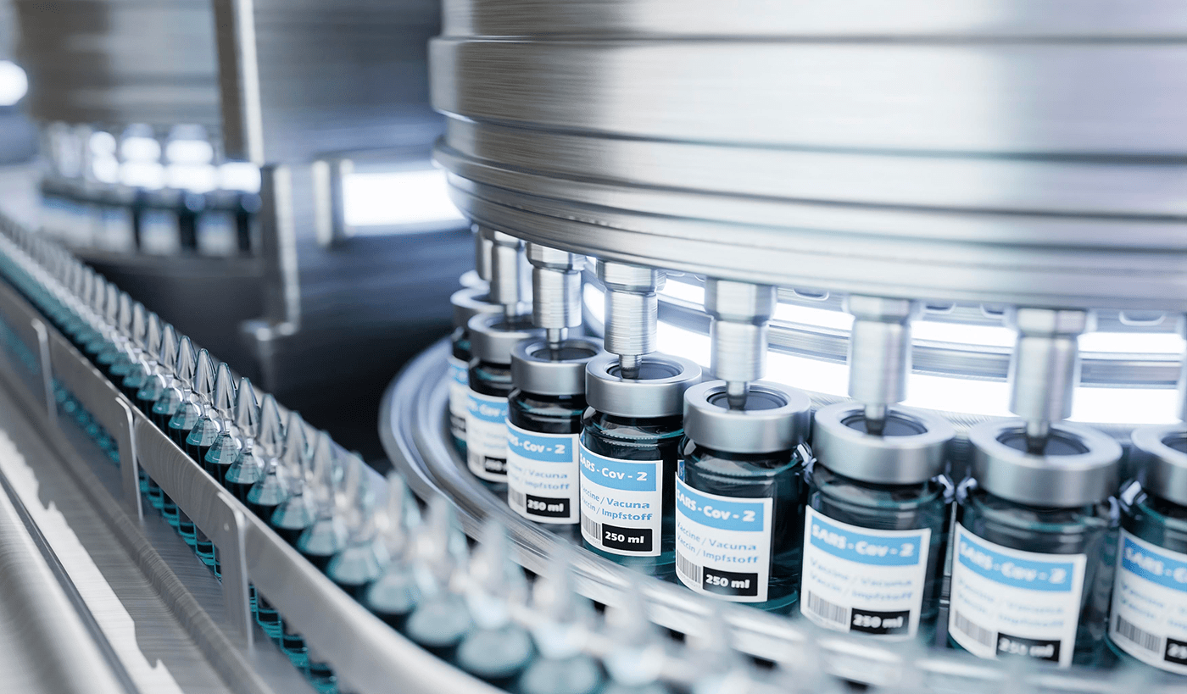


UK REACH product portfolio: applications
Printing Inks, Coating & Adhesives
Pharma, Food & Feed
Butyl Acetate (BUTAC)
Butyl Acrylate (BA)
Dibasic Ester (DBE)
N-Propyl Acetate (N-PAC)
Benzoic Acid (Tech Grade 99%)
EDTA (Sodium Salts)
EDTA (Magnesium Salts)
EDTA (Manganese Salts)
EDTA (Copper Salts)
Ethyl Acetate (ETAC)
Sodium Calcium Edetate
Triacetin (Food Grade / Tech Grade /
RSPO / Palm Oil Free)
Benzaldehyde
Benzyl Alcohol
Benzyl Benzoate
Citric Acid Anhydrous
Performance Chemicals
Caustic Soda (Solution, Flakes & Pearls)
Propylene Carbonate (PC)
Rubber / Latex
Methyl Methacrylate (MMA)
Methyl Ethyl Ketone (MEK)
Surfactants / Water Treatment Chemicals
Plant Protection / Agriculture
Formic Acid 85% (FA 85%)
Tri-ethyl Amine
Personal Care And Cosmetics
Resins
Liquid Epoxy Resin
Maleic Anhydride (Briquettes / Molten)
Iso Propyl Alcohol (IPA)
Sodium Benzoate

Slide 29




EU REACH registered products: Indian-origin
Printing Inks, Coating and Adhesives
Flame Retardants
2-Methyl Cyclohexyl Acetate
Acetonitrile
Diacetone Alcohol
Dimethylformamide
Phenoxy Ethanol
Triethyl Phosphite (TEP)
Trimethyl Phosphite
⁠Triphenylphosphine
Personal care and cosmetics
Pharma, food and feed
2-Methoxy Naphthalene
Castor Oil
Linseed Oil Fatty Acid
Oleic Acid
Rape Oil Fatty Acid
1-Acetyl Naphthalene
2-Acetyl Naphthalene
Acetic Anhydride (AAH)
Ethyl Acetate (ETAC) - Normal & Bio-Based
Ethyl Amine (Mono & Tri)
Ethylenediamine (EDA)
Phosphoric Acid (Food Grade)
Phosphorus Pentachloride
Polysorbate
Sorbitol Liquid 70%
Sunflower - Oil fatty acid

Slide 30



EU REACH registered products: Indian-origin
Flavors and Fragrances
Plant Production / Agriculture
Aldehyde C16 (Strawberry Aldehyde)
4-Methyl Acetophenone
Benzyl Alcohol (Tech Grade)
Benzyl Salicylate
Benzaldehyde
Cinnamic Alcohol
Cinnamic Aldehyde
Iso Propyl Alcohol (Food Grade)
Phenoxy Ethyl Iso Butyrate
Phenyl Ethyl Acetate
Phenyl Ethyl Alcohol
Phenyl Ethyl Methyl Ether
Phenyl Ethyl Phenyl Acetate
Styrallyl Acetate
Styrene Oxide
Acrolein (Propenal)
Benzyl Amine
Diethyl Amino Ethanol (DEAE)
Diethyl hydroxylamine (DEHA)
Gamma-Butyrolactone (GBL)
Methylene Chloride
N,N-Diisopropylethylamine
Morpholine
Surfactants / Water Treatment Chemicals
Acrylamide Liquid (30%/40%/50%)
Dimethyl Sulphate
Lauryl Nitrile
Oleyl amine
Polyethylene Glycol
Propenonitrile
⁠Sorbitan monooleate
Stearyl Amine
Tallow Amine
Performance Chemicals
2-Ethylhexyl Nitrate
3,3,5-Trimethyl Cyclohexanone
Caustic Soda (Flakes)
Gamma-Butyrolactone
Hexylene Glycol
N-Ethyl-2-Pyrrolidone (NEP)
N-Methyl-2-Pyrrolidone (NMP)
Rubber / Latex
Carbon Black

Slide 31

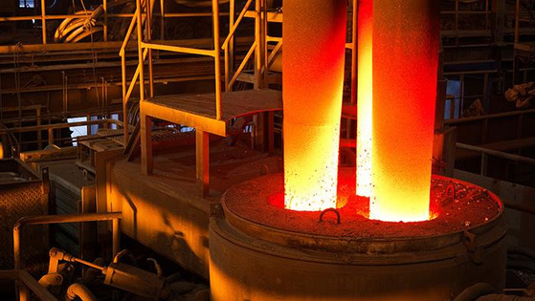

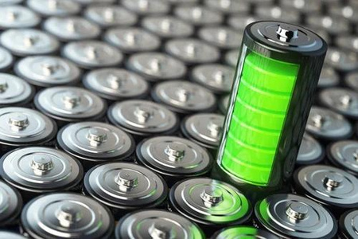
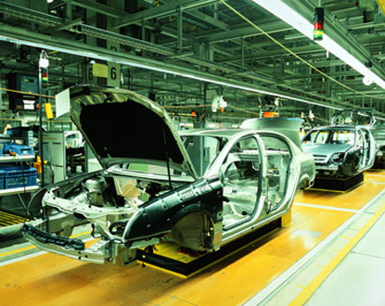



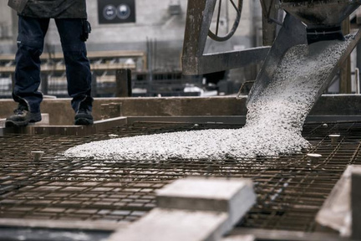



We impact the following end-markets
Pharmaceuticals
Graphite Electrodes
Defence
Lithium-Ion Batteries
Automotive
Rubber Industries
Paints, Plastic & Fibre
Power Infrastructure
Construction Chemical
Wood Preservative
Oils
Personal Care

Slide 32



Navigating challenges: A case study in proactive solutions & strategic coordination
The case study highlights how our proactive approach and strategic coordination helped navigate a unique challenge, underscoring company’s commitment to delivering results despite adversity.
Product: BISPHENOL A
Problem: Navigating Customs Challenges for Timely Delivery
Solution: A Strategic Roadmap
to Success
Benefits: Delivering Value
Beyond Expectations
Client & Product: One large order of Bisphenol A, a vital component with multiple end-users.
Stakeholders Involved: Supplier, Customer, Customs inspection team, Warehouse representative, Gas doctor.
Critical Issue: Customs inspection delay jeopardizing production schedules, customer relations, and supply chain flow.
  Proactive Engagement: Our quick response and coordination ensured all stakeholders were aligned.
  Revised Timeline: Successfully negotiated a new inspection date from the initially unfeasible date.
  Precise Execution: Collaborated with gas doctor to provide necessary gas measurement and certification, a key requirement for clearance and implementing contingency plans.
Timely triumph: Ensuring uninterrupted operations
Trusted Collaboration: Strengthening Global Partnerships
Exceptional Relationship Building: Enhancing Client Satisfaction
Notes:
31

Slide 33

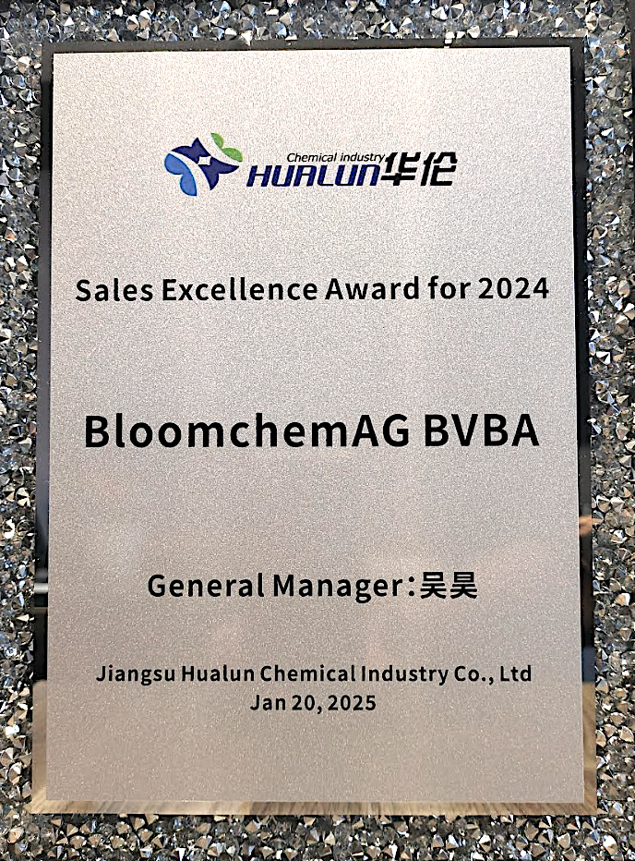


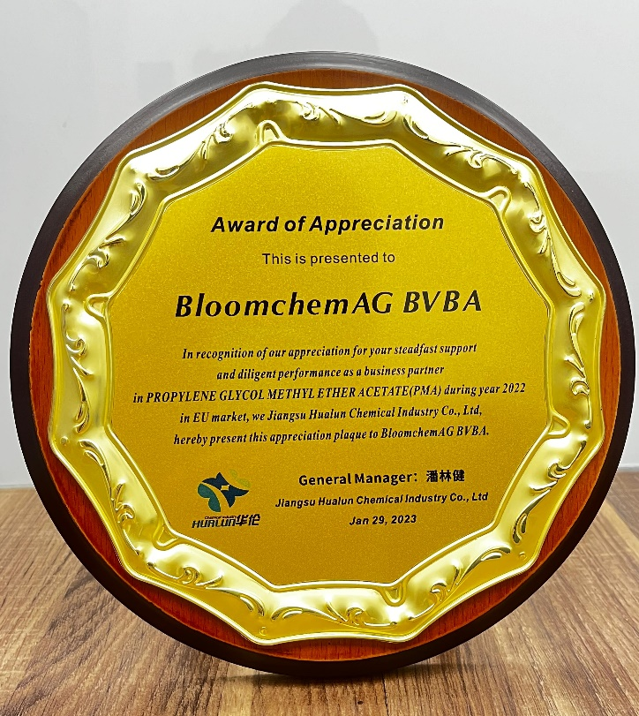




Awards and accreditations
EcoVadis
Certified
Inspection & Investigation
Certificate
D & B Certificate
ISO 9001: 2015 Certified
Certified for Sustainability
Excellence - April 2026
Approved by Cel Precursory Unit, Belgium (Category 2A & Category 3)
Part of Dun & Bradstreet Global Database
All our processes are well documented and assessed by Surveyors
Registered Merchant Certificate
Certificate of
Importer-Exporter
  Make in India
VAT Registered
Registered as a Merchant Exporter
by CHEMEXCIL
  MSME Make in India :
  DRIVE
Registered under
State VAT

Slide 34



Awards and accreditations
BloomchemAG has been awarded the committed batch
in recognition of its
Ecovadis Rating

Slide 35



Sustainability initiatives
Comprehensive Commitment to Safety and Compliance
Global Responsibility and Ethical Engagement
Compliance Assurance
  At BloomchemAG, safety and compliance are central to our operations, guided by TQM.
  Our ISO 9001:2015 certification demonstrates our commitment to standardized processes and global compliance.
  At BloomchemAG, products spanning 1,000,000 global miles annually, we prioritize environmental responsibility, health, and safety for our supply chain.
  Our memberships in DUN & BRADSTREET and ZENITO highlight our commitment to global citizenship, social security, and community support.
  At BloomchemAG, our policy strictly involves dealing only with the products that adhere to the REACH regulations and other applicable regulations.
  BloomchemAG has pre-registered all the chemicals in its current portfolio which are mandated to be registered under REACH.
100 Students Educated
Education Initiatives

Slide 36




Financial partners
BloomchemAG Private Limited
BloomchemAG BV

Slide 37


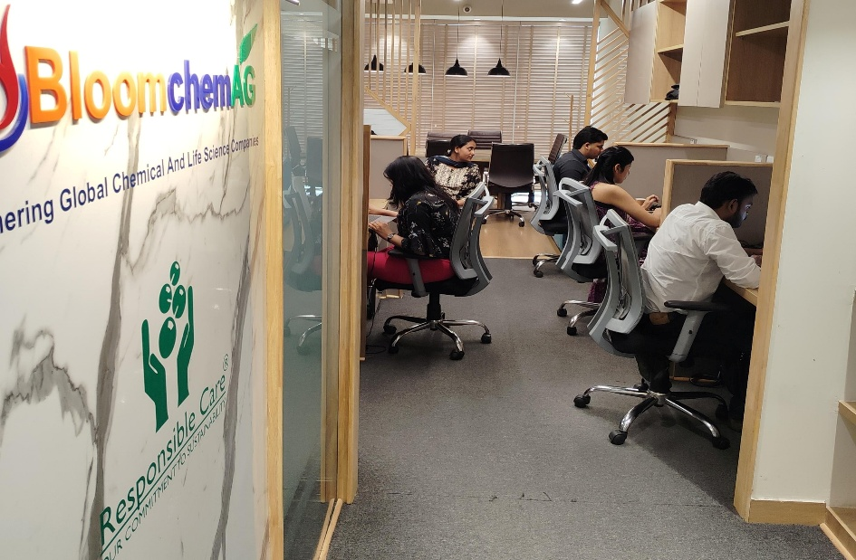
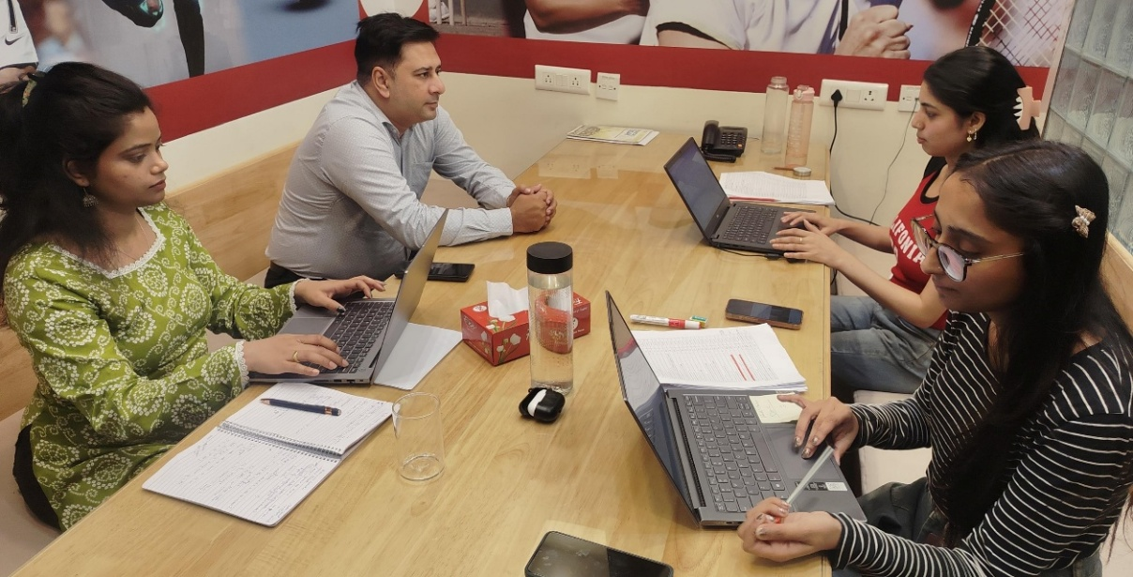
Life at Bloomchemag
Where People Grow, Collaborate & Create Impact
Work Culture 🤝
What Makes Bloomchemag Special 🌟
Collaborative & Open Culture
Flat hierarchy with easy access to leadership
Cross-functional teamwork (SCM, Ops, Sales)
Ideas are welcomed and acted upon
Close-knit team environment
Visible individual impact on business outcomes
Fast learning curve compared to larger organizations
Culture of trust, ownership, and growth
Ownership & Agility ⚡
Learning & Growth 📚
Startup-Like Ownership
High responsibility from early stages
Fast decision-making environment
Freedom to experiment and improve processes
Continuous Learning Environment
Learning by doing on real business challenges
Exposure across multiple functions
Mentorship from experienced professionals
People & Energy 👥
Young Energy + Experienced Guidance
Dynamic young workforce
Strong leadership support
Balanced mix driving innovation + stability

Slide 38

Bloomchemag Workforce Snapshot
A Balanced, Experienced & Stable Team
Average Association (Tenure) ⏳
Average Age 👤
35 Years
4 Years
A young yet mature workforce
Young workforce, strong retention, enabling expansion hiring
Gender Diversity 👩‍💼👨‍💼
Average Experience🎓
2 : 3 (Male : Female)
12 Years
Balanced and inclusive workforce
Deep industry expertise across teams
Notes:
Expansion hiring

Slide 39




Contact Us
+91 7291974050; 7291974482; 7291999344
+32 14322136; 14326398
sales@BloomchemAG.com | marketing@BloomchemAG.com
exports@BloomchemAG.com
www.BloomchemAG.com
https://www.linkedin.com/company/BloomchemAG-belgium
BloomchemAG Private Limited
Unit 104-105-108-114, Tower 1, Assotech Business Cresterra (ABC), Sector 135, Noida – 201305, India
GST IN 09AAFCB5025N1ZG
Subsidiary: BloomchemAG BV​
Sint-Antoniusstraat 16 b1, B-2400, Mol, Belgium​​
BTW BE 0544.589.474
NL 824.354.771.B01

